Slide 1



Virtual Striking Competition
2021/2022
Please submit your results to Kate Voice (SGO) at bassetlawsgo@retfordoaks-ac.org.uk
Deadline to enter results-

Slide 2


Introduction to the Virtual Invasion Competition
Here’s a brief introduction which we hope will help you make the most out of these resources. If you have any questions, please get in contact with Kate Voice (bassetlawsgo@retfordoaks-ac.org.uk).
Print, copy and handout the individual scorecards to all pupils in your class. This scorecard will be in the excel document sent to your PE lead.
Please ensure you refer to and use the correct scoring table in order for pupils to know what they are aiming at/working towards. This is in the word document sent to your PE lead.
Ask pupils to complete the activities and ensure pupils record their scores on their card. Pupils should be encouraged to record their first attempt, then use time in class, during breaks and at home to improve their performance.
A final personal best score should be recorded.
Collect or collate the scorecards from the pupils and enter the data onto the relevant year group/class scoring sheet tab on the excel spreadsheet.
Submit/send the class scoring sheet to the PE lead who will collate all class data for the school.
PE leads only: Please collate all class scores on the summary sheet and send this document only to your SGO by locally given/agreed date. Any problems contact your SGO.
Please note that to help with scoring, some cells are locked on various parts of the spreadsheet. Please do not attempt to unlock the cells.
AHU
SGO
KV
SGO

Slide 3






Spirit of the School Games
We are confident that everyone involved in the School Games will adopt and abide by the School Games values, but just in case here they are. These six values were developed by young people. They focus on personal excellence through competition and demonstrate what the School Games should be built around.
Honesty
With others and with yourself. Have the courage to do the right thing. Be truthful and promote fairness in every situation.
Self belief
You’ve got to believe to achieve. Have the self-belief and confidence to succeed and reach your personal best.
Respect
Treating others politely and with understanding. Accepting life’s ‘ups and downs’ with grace. Respect every day, in everything you do and for everyone around you.
Teamwork
Treat everyone equally, support each other and work together to have fun and achieve. Celebrate each other's success. Be a good friend and a positive team player in school, sport and life.
Passion
Giving it 100%, putting your heart and soul into whatever you are doing and never giving up. Care about what you do and the people around you and approach each opportunity with enthusiasm and positivity.
Determination
Keep going no matter what. Determination is about the journey you go on to push yourself and achieve your dreams. Have the mental strength and the self-discipline to overcome obstacles, commit to your goals and keep working every day to become the very best you can be. Don’t hold back!

Slide 4
The 5 Challenges
Tennis Tap Ups
Pick up & Throw
Table Target
KV
Batting for Rounder’s
Hit the Wicket
Tennis Tap Ups
Pick up and Throw
Table Target
Batting for Rounders
Hit the Wicket
Aim-To complete as many tennis tap ups as possible in 60 seconds
Aim-Roll the ball forward into the target zone, retrieve the ball and throw the ball back at the target. How many in 60s?
Aim- How many times can you get the ball into the target in 60s?
Aim-To strike the ball with a rounder's bat through the cones
Aim-To bowl the ball accurately, under or overarm, at a set of cricket wickets
1x Stopwatch
1x Tennis Racket
1x Tennis Ball
1x Tennis Ball
Cones
Hoop
1x Table Tennis Bat (Small Bat)
1x Table Tennis ball
Table (Any)
1x Cone
1x Rounders Bat
1x Rounders Ball
6x Cones
1x Cricket Wickets
2x Red cones, 2 x Yellow Cones
1x Soft ball (Tennis ball size)

Slide 5

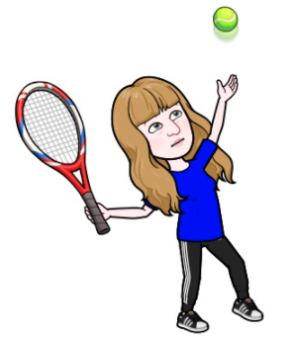
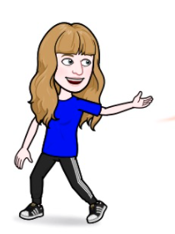
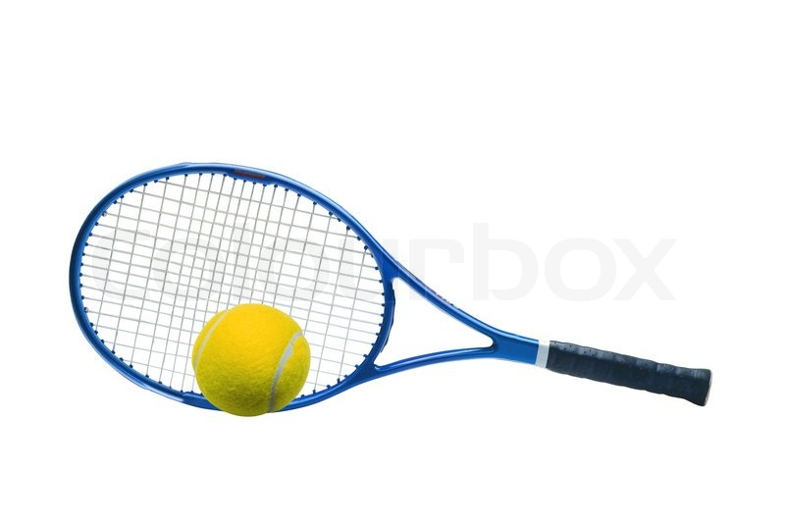
How to improve?
Equipment Needed
Tennis Tap Ups
1x Tennis Ball (soft ball)
1x Tennis Racket
1x Stopwatch
Aim to keep the ball below head height using little taps.
Tap the ball upwards and not use big swings.
KV
Overview
Scoring & Judging
A sports leader will time 60 seconds. Count the number of tap ups you complete in 60 seconds. Remember if the ball hits the floor you must start again. The highest rally is the score recorded.
Aim- Using a tennis racket complete as many tap ups as possible in 60 seconds
Year Group | Bronze | Silver | Gold
Years 1 & 2 | 5-6 | 7-8 | 9+
Years 3 & 4 | 10-11 | 11-15 | 16+
Years 5 & 6 | 12-15 | 16-25 | 25+
The Rules
Make it easier/harder
The ball must be volleyed in the air and then tapped up consecutively without the ball bouncing
If you drop the ball retrieve it and carry on but your score goes back to zero and you start counting again
Easier- Use a larger ball or bigger bat
Harder-Use a smaller ball, rotate the racket after every tap up (forehand and backhand)

Slide 6


How to improve?
Equipment Needed
Pick up and Throw
1x Tennis Ball (soft ball)
1x hoop
Tape Measure
Cones
Roll the ball softly into the target zone to make it easier to collect.
Take time and aim before throwing the ball at the target.
KV
Overview
Scoring & Judging
5m
5m
A sports leader will time 60 seconds. The ball must be rolled into the target zone to count. The number of times the ball is thrown into the hoop should be counted. Count how many balls land in the hoop in 60 seconds
Aim- Roll the ball forward into the target zone, retrieve the ball and throw the ball back at the target. How many in 60s?
Year Group | Bronze | Silver | Gold
Years 1 & 2 | 3-4 | 5-6 | 7+
Years 3 & 4 | 5-8 | 9-11 | 12+
Years 5 & 6 | 8-12 | 13-17 | 18+
The Rules
Make it easier/harder
Place a hoop on the floor, start next to the hoop, roll the ball forward 5m into a 5m target zone, run collect the ball with one hand and throw the ball back into the hoop. Repeat for 60s to see how many you can get in the hoop.
Easier- Use a larger ball or bigger bat
Harder-Use a smaller ball, rotate the racket after every tap up (forehand and backhand)

Slide 7
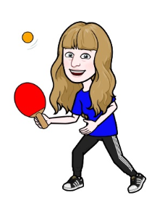
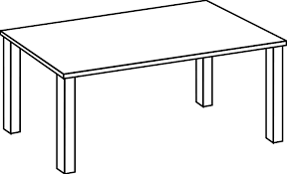
How to improve?
Equipment Needed
Table Target
1x Table Tennis Bat (Small Bat)
1x Table Tennis ball
Table (Any)
1x Cone
Aim to keep the ball below head height using little taps.
Tap the ball upwards and not use big swings.
KV
Overview
Scoring & Judging
1m
A sports leader will time 60 seconds. Count the number of tap ups you complete in 60 seconds. Remember if the ball hits the floor you must start again. The highest rally is the score recorded.
Aim- How many times can you get the ball into the target in 60s?
Year Group | Bronze | Silver | Gold
Years 1 & 2 | 3-4 | 5-6 | 7+
Years 3 & 4 | 4-6 | 7-8 | 9+
Years 5 & 6 | 7-8 | 9-10 | 11+
The Rules
Make it easier/harder
On a table place a target (upside down cone) 1 meter away from where you will stand. Hit the ball onto the table so that it bounces once aiming for the ball to go into the target. Repeat this for 60s to see how many times the ball goes in the target
Easier- Allow the ball to bounce twice before it goes into the target. Make the target bigger.
Harder-Stand further away from the target, make the target smaller.

Slide 8
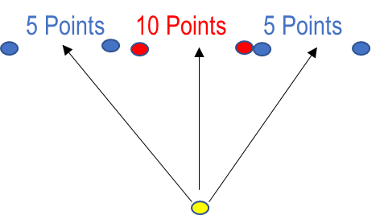
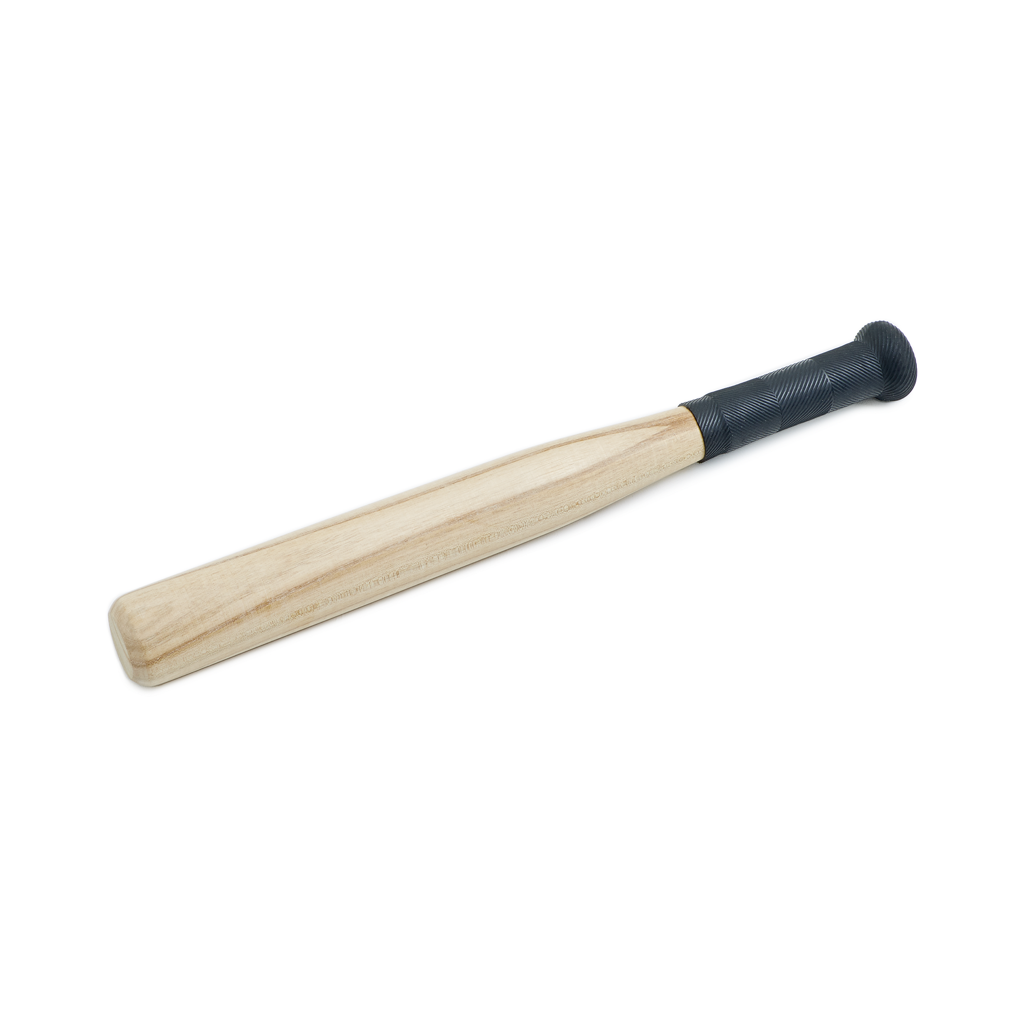
Batting for Rounders
How to improve?
Equipment Needed
1x Tennis Ball (soft ball)
1x Tennis Racket
1x Stopwatch
Keep your eyes on the ball and swing as it comes near
Stand sideways on and do not try to swing to hard
KV
Overview
Scoring & Judging
10 points are scored if the ball is struck between the red cones
5 points are scored if the ball is struck between the blue cones
2 points are scored if the ball is struck cleanly and misses the cones
A leader should add up the total score for all 5 hits
Aim- To strike the ball with a rounder's bat through the cones
Age Group Differentiation
Y1/2 – Cones placed 2 metres apart. Batter to strike the ball from 5 metres away.
Y3/4 – Cones placed 1 metre apart. Batter to strike the ball from 8 metres away.
Y5/6 – Cones placed 1 metre apart. Batter to strike from 10 metres away.
Year Group | Bronze | Silver | Gold
Years 1 & 2 | 5-10 | 11-19 | 20+
Years 3 & 4 | 10-20 | 21-29 | 30+
Years 5 & 6 | 20-30 | 31-39 | 40+
The Rules
Make it easier/harder
The teacher/leader feeds/bowls the ball underarm
For KS1 pupils the ball can be dropped from waist height at their side to help them hit the ball
Students get 5 attempts to hit the ball and should aim to hit the ball in between the target zones to score points
Easier- Use a larger ball or bigger bat, allow the ball to bounce once before hitting
Harder-Use a smaller ball, move the targets further back/make them smaller

Slide 9
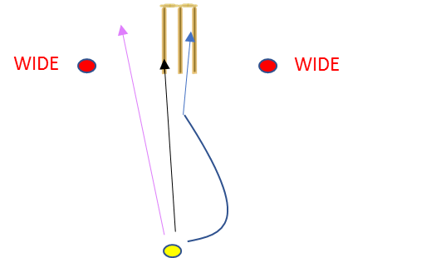
Hit the Wicket
Equipment Needed
How to improve?
1x Tennis Ball (soft ball)
1x Wicket
2x Red cones, 1x Yellow cone
Aim for the target. Take one step with your weak foot when you bowl
KV
Overview
Scoring & Judging
10 points scored if the ball bounces once and hits the wickets
5 points are scored if the ball does not bounce and hits the wickets or bounces more than once and hits the wickets
2 points scored if the ball, bounces once, misses the wickets but passes between the red cones
Aim- To bowl the ball accurately, under or overarm, at a set of cricket wickets
Age Group Differentiation
Year group(s) 1/2 – Wickets placed 3 metres away (underarm bowl)
3/4 – Wickets placed 6 metres away (Y3 underarm, Y4 overarm)
5/6 – Wickets placed 8 metres away (overarm bowl)
Year Group | Bronze | Silver | Gold
Years 1 & 2 | 10-14 | 15-19 | 20+
Years 3 & 4 | 18-26 | 27-34 | 35+
Years 5 & 6 | 23-33 | 34-44 | 45+
The Rules
Set up your wickets with 2 red cones, 3m apart, either side and a cone to bowl from (see diagram)
A sponge, tennis ball or wind ball can be used
The ball is bowled towards the wickets and points scored depending where the ball goes
Bowl 6 balls (i.e., one over)
Make it easier/harder
Easier- Move closer to the wickets. Make the target zones larger
Harder-Move further away from the wickets. Make the target zones smaller

Slide 10
Submitting Scores
Student Scorecard Name-
Challenge | Attempt 1 | Attempt 2 | Attempt 3 | Best Score
Tennis Tap Ups
Pick up and Throw
Table Target
Batting for Rounders
Hit the Wicket
Step by Step Guide
Step 1- Give each student an individual scorecard and get them to record the data as they complete the challenges
Step 2- Collect all the student scorecards and enter the best score for each challenge onto the class spreadsheet
Step 3- At the bottom of the class score sheet enter the number of participants and the total class score. This will give your class an average score.
Step 4- Collate all the average for each class onto the school summary sheet and submit this to bassetlawsgo@retfordoaks-ac.org.uk before the deadline
Step 5- The Bassetlaw SGO will then collate the scores and will identify the top 3 placing schools for each year group. These schools/classes will receive a certificate as will any individuals who take part.

Slide 11
Student Scorecard Name-
Challenge | Attempt 1 | Attempt 2 | Attempt 3 | Best Score
Tennis Tap Ups
Pick up and Throw
Table Target
Batting for Rounders
Hit the Wicket
Student Scorecard Name-
Challenge | Attempt 1 | Attempt 2 | Attempt 3 | Best Score
Tennis Tap Ups
Pick up and Throw
Table Target
Batting for Rounders
Hit the Wicket
Student Scorecard Name-
Challenge | Attempt 1 | Attempt 2 | Attempt 3 | Best Score
Tennis Tap Ups
Pick up and Throw
Table Target
Batting for Rounders
Hit the Wicket

