Slide 1
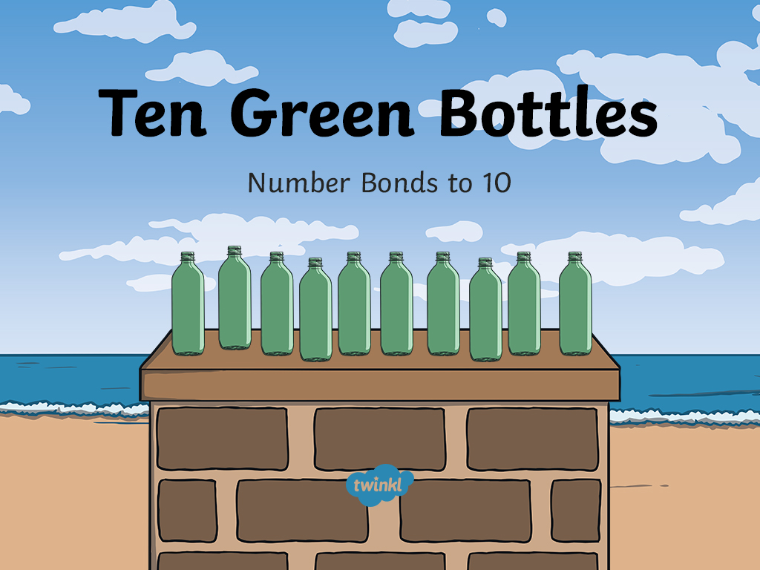

Slide 2

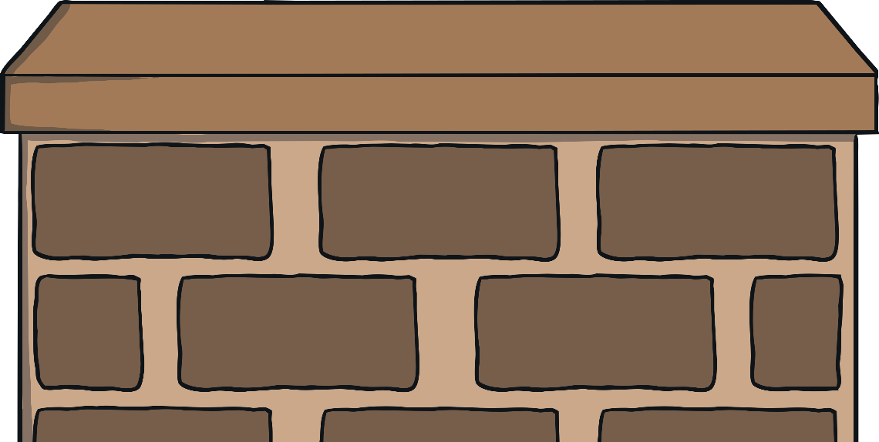
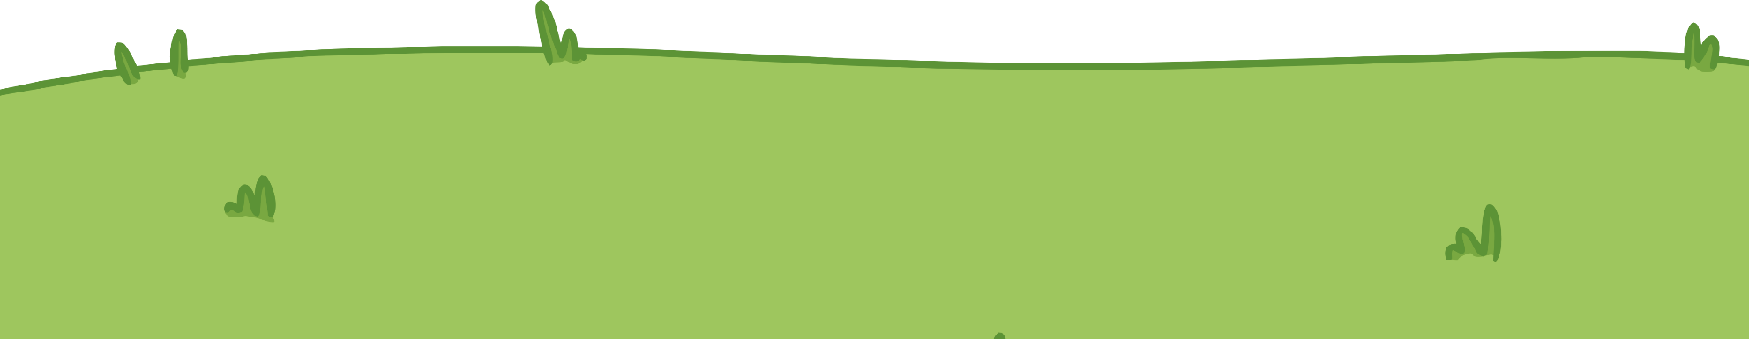
Ten green bottles standing on the wall,
Ten green bottles standing on the wall,
And if zero green bottles should accidentally fall,
There’ll be ten green bottles standing on the wall.
10
+
0
=
10

Slide 3

10
10
+
0
=
10

Slide 4
Ten green bottles standing on the wall,
Ten green bottles standing on the wall,
And if one green bottle should accidentally fall,
There’ll be nine green bottles standing on the wall.
9
+
1
=
10

Slide 5
10
9
+
1
=
10

Slide 6
Ten green bottles standing on the wall,
Ten green bottles standing on the wall,
And if two green bottles should accidentally fall,
There’ll be eight green bottles standing on the wall.
8
+
2
=
10

Slide 7
10
8
+
2
=
10

Slide 8
Ten green bottles standing on the wall,
Ten green bottles standing on the wall,
And if three green bottles should accidentally fall,
There’ll be seven green bottles standing on the wall.
7
+
3
=
10

Slide 9
10
7
+
3
=
10

Slide 10
Ten green bottles standing on the wall,
Ten green bottles standing on the wall,
And if four green bottles should accidentally fall,
There’ll be six green bottles standing on the wall.
6
+
4
=
10

Slide 11
10
6
+
4
=
10

Slide 12
Ten green bottles standing on the wall,
Ten green bottles standing on the wall,
And if five green bottles should accidentally fall,
There’ll be five green bottles standing on the wall.
5
+
5
=
10

Slide 13
10
5
+
5
=
10

Slide 14
Ten green bottles standing on the wall,
Ten green bottles standing on the wall,
And if six green bottles should accidentally fall,
There’ll be four green bottles standing on the wall.
4
+
6
=
10

Slide 15
10
4
+
6
=
10

Slide 16
Ten green bottles standing on the wall,
Ten green bottles standing on the wall,
And if seven green bottles should accidentally fall,
There’ll be three green bottles standing on the wall.
3
+
7
=
10

Slide 17
10
3
+
7
=
10

Slide 18
Ten green bottles standing on the wall,
Ten green bottles standing on the wall,
And if eight green bottles should accidentally fall,
There’ll be two green bottles standing on the wall.
2
+
8
=
10

Slide 19
10
2
+
8
=
10

Slide 20
Ten green bottles standing on the wall,
Ten green bottles standing on the wall,
And if nine green bottles should accidentally fall,
There’ll be one green bottle standing on the wall.
1
+
9
=
10

Slide 21
10
1
+
9
=
10

Slide 22
Ten green bottles standing on the wall,
Ten green bottles standing on the wall,
And if ten green bottles should accidentally fall,
There’ll be zero green bottles standing on the wall.
0
+
10
=
10

Slide 23
10
0
+
10
=
10

Slide 24

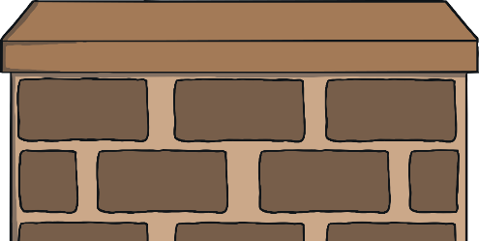

Can you complete the number bonds?
2
+
8
=
10
3
+
7
=
10
0
+
10
=
10
6
+
4
=
10

Slide 25
